Slide 1


Intro to
Programming
With python
classes:
part 1II
Monday, May 5 2025 TOH210
Notes:
Layout objects pulled from: https://slidesgo.com/
All icons are from: https://thenounproject.com/

Slide 2

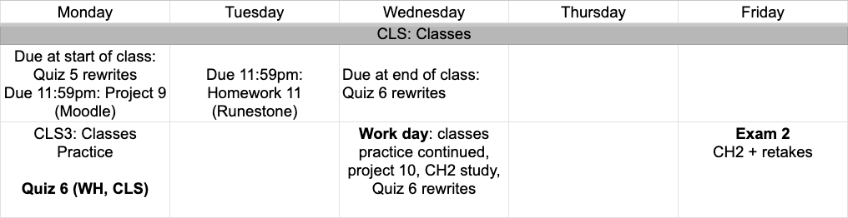
this week
google sheet link
Notes:
https://docs.google.com/forms/d/e/1FAIpQLSe3OloPAJSid4n6cyU_4qXpRWU7FOSmP7IVdRS_vh9cvYd9zQ/viewform?usp=sharing

Slide 3
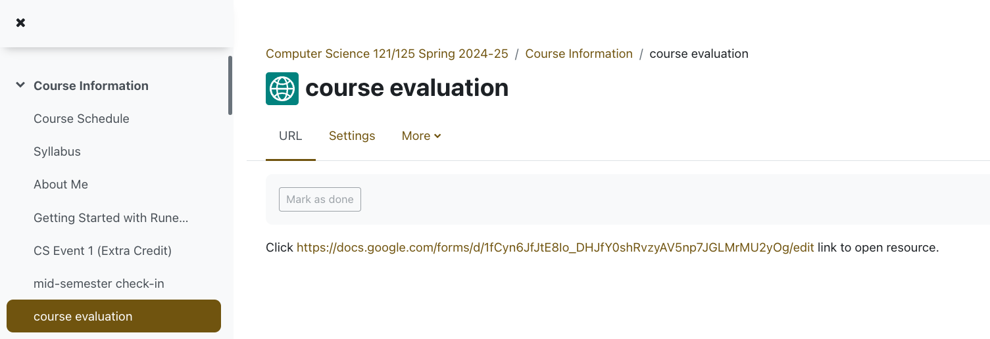

Slide 4
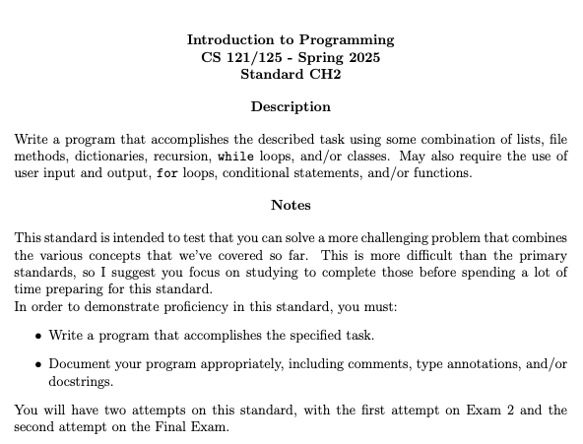

Slide 5
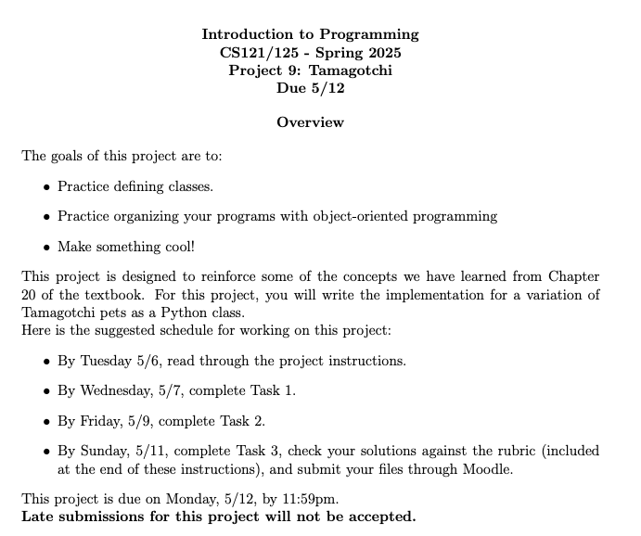
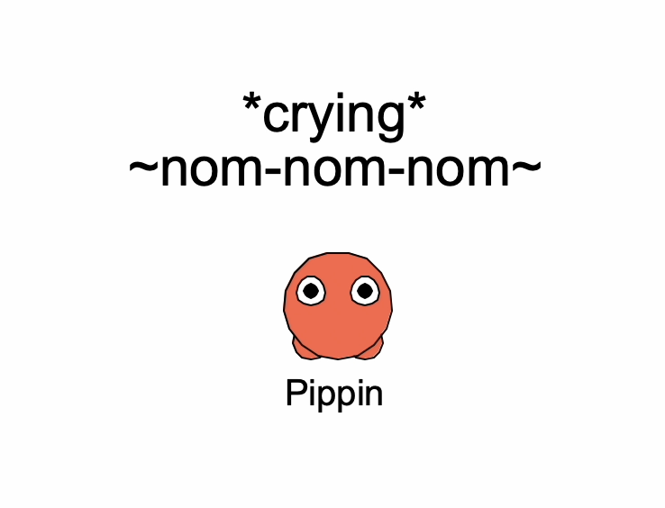
Project 10

Slide 6
Takeaways from last time
working with classes
__str__ method

Slide 7
You may have noticed that if you print out your instance you get something like:
<__main__.Pizza object at 0x789181a0e020>
We can define the string representation of a class by defining a special method _ _str_ _
This changes what happens when you print an instance
of the class
class Pizza:
#str method
def __str__(self):
return self.size
+" pizza with "
+ (" & ").join(self.toppings)
prizza = Pizza("large")
prizza.add_topping("red onion")
prizza.add_topping("pineapple")
print(prizza)
large pizza with red onion & pineapple

Slide 8

review
bank account
Define a class called BankAccount, with the following:
member variables
account_number: an int given as an argument to the constructor
balance:a float, initialized to 0.00
member functions
deposit: takes a float, and adds it to the balance
__str__: returns string representation of “Account <account_number> has $ <balance>”

Slide 9
class BankAccount:
def __init__(self, num:int):
self.account_number = num
self.balance = 0.00
def deposit(self, money:float):
self.balance += money
def __str__(self):
return f"Account {self.account_number} has ${self.balance}"
constructor
mutator
accessor

Slide 10
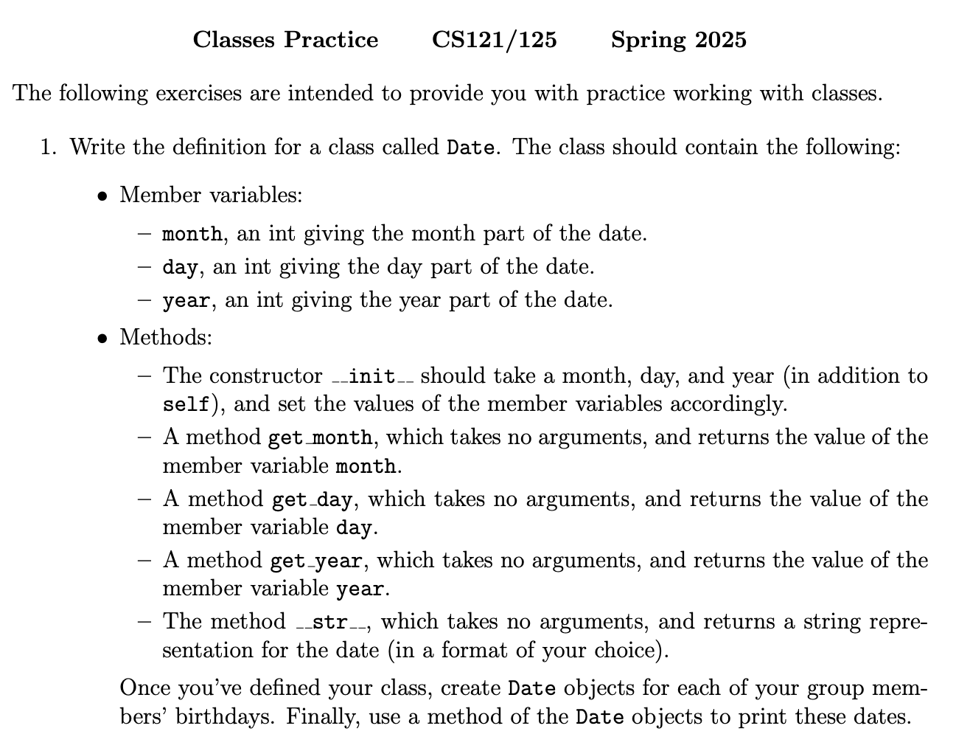
grab a partner and whiteboard marker, taking turns with who is planning out the program on the board and who is typing it up in a Python script.

Slide 11
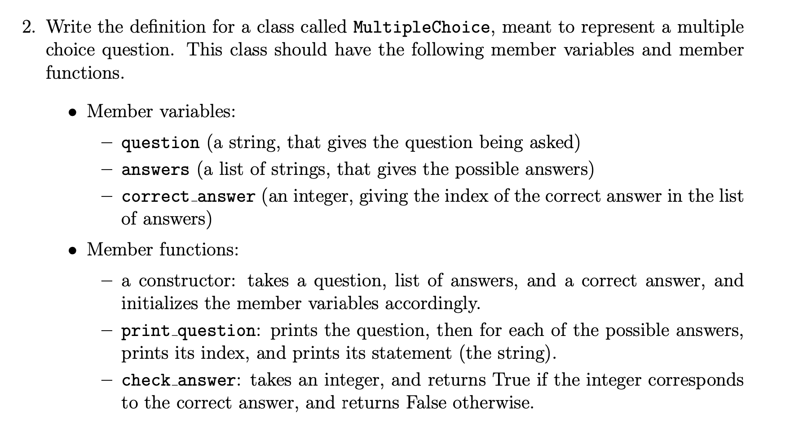
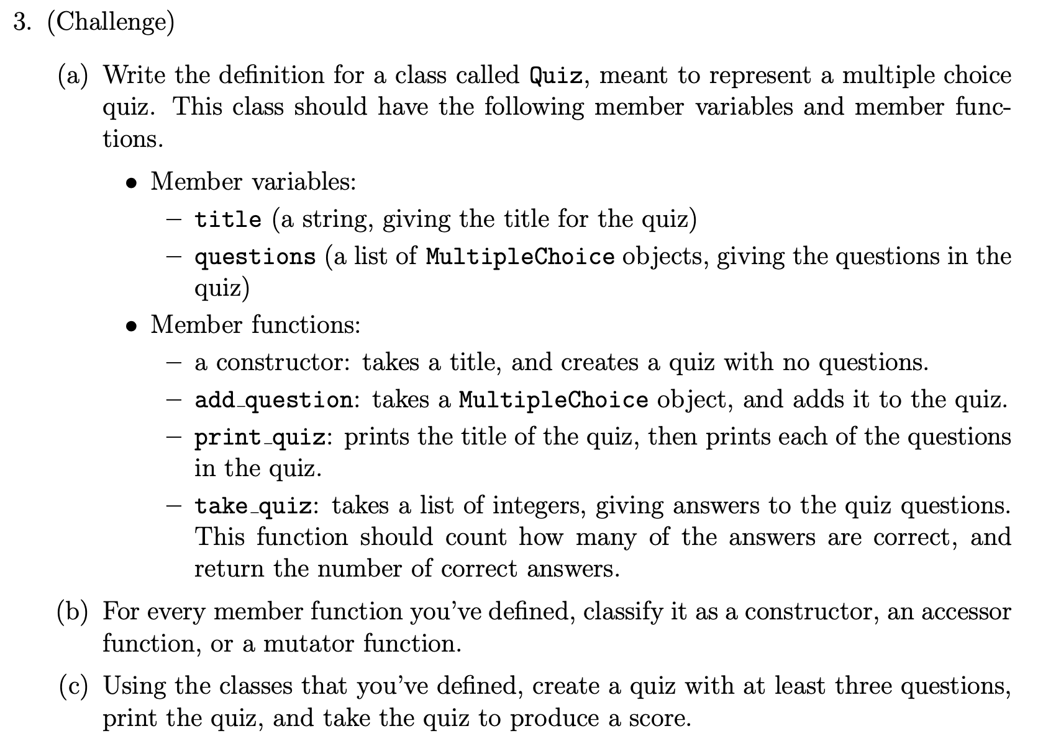

Slide 12

before next time
Continue with worksheet
Start Project 10
Study for Quiz 6
Fill out Course Eval

Slide 13
Intro to
Programming
With python
Workday + Quiz 6 rewrites
Wednesday, May 7 2025 TOH210
Notes:
Layout objects pulled from: https://slidesgo.com/
All icons are from: https://thenounproject.com/

Slide 14
this week
google sheet link
Notes:
https://docs.google.com/forms/d/e/1FAIpQLSe3OloPAJSid4n6cyU_4qXpRWU7FOSmP7IVdRS_vh9cvYd9zQ/viewform?usp=sharing

Slide 15
Start Here
Do any rewrites for Quiz 6.
Come up and double check with me to make sure the code looks good.
Continue your adventure
Questions 2-3 from Classes 3 slide deck
Practice Questions from CH2 pdf up on Moodle
Project 10: Tamagotchi

Slide 16
before next time
Work on Project 10
Study for CH2 + rewrites
Fill out course evaluations

